Slide 1
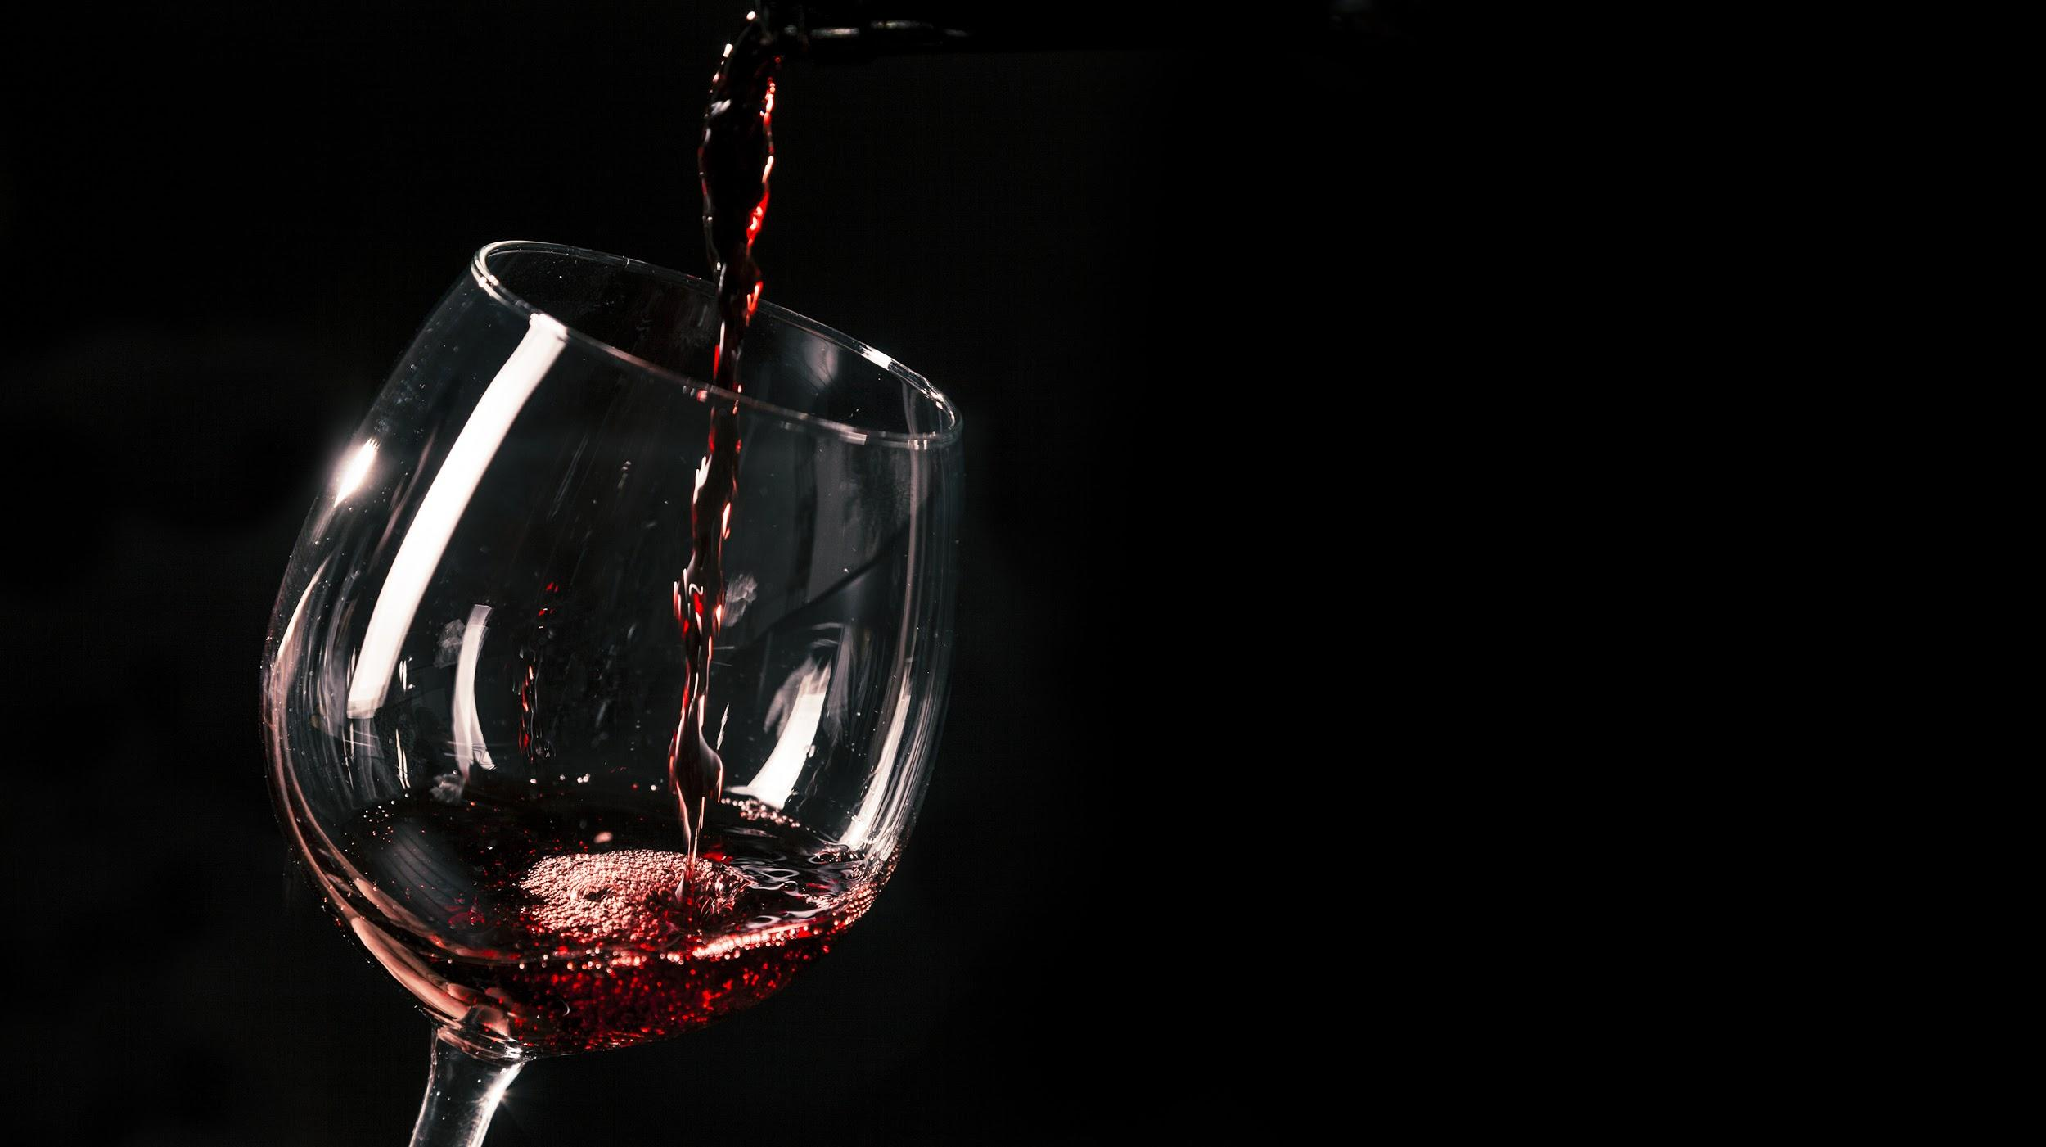
WHICH PHYSIOCHEMICAL PROPERTY IMPACTS THE QUALITY OF WINE THE MOST?
Group 1: Shoma Babulal, Alexandra Garolfali, Fang Li, Lily Lao, Tiffany Ramkaran, Ziwen Zhang

Slide 2
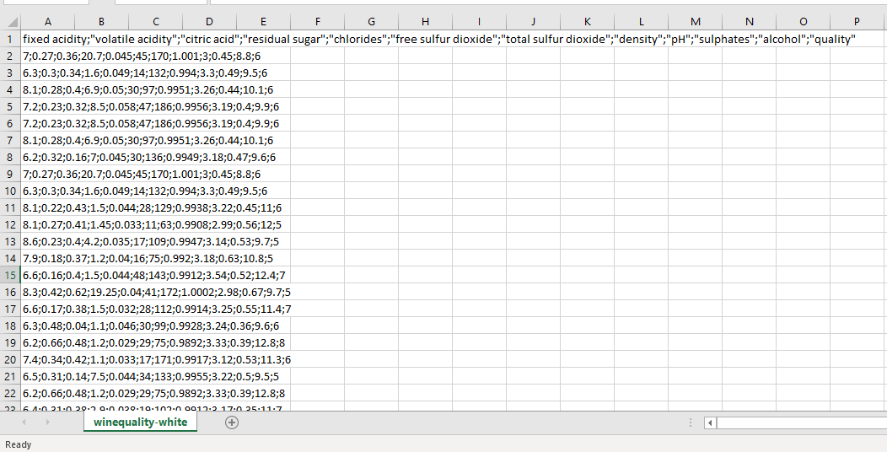
Determine which property impacts quality of wine the most through regression analysis
PHYSIOCHEMICAL PROPERTIES
Fixed acidity
Volatile acidity
Citric acid
Residual sugar
Chlorides
Free sulfur dioxide
Total sulfur dioxide
Density
pH
Sulphates
Alcohol
QUALITY
(1 – 10, 10 being highest)
DATASET
.csv semicolon delimited
Vinho Verde wines from Portugal
4,898 records
1,599 records
Data Source: UC Irvine Machine Learning Repository

Slide 3
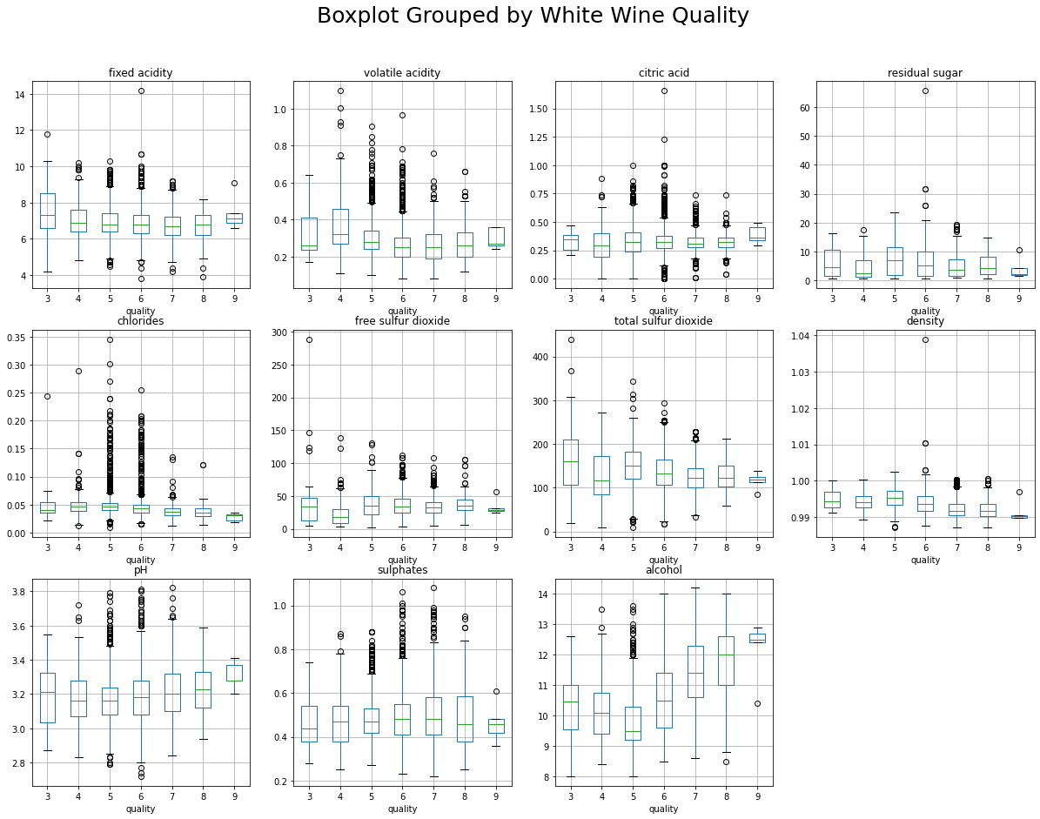
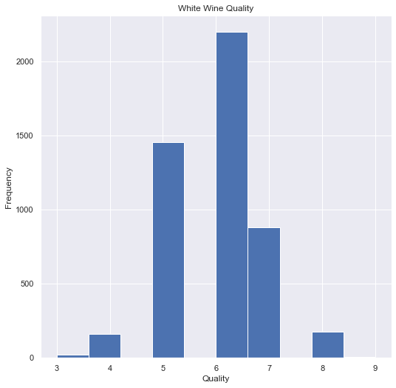
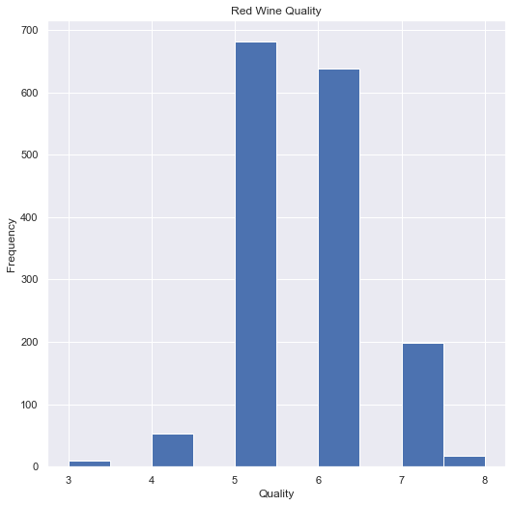
Begin by exploring the variables
INDEPENDENT VARIABLES: PROPERTIES
Box-plots & interquartile ranges to determine range of each property at different quality levels
DEPENDENT VARIABLE: QUALITY
Range of quality in datasets
Distribution of quality in datasets
*
3-9
3-8
* Run code to see red dataset box-plots, and interquartile range details for both
datasets

Slide 4

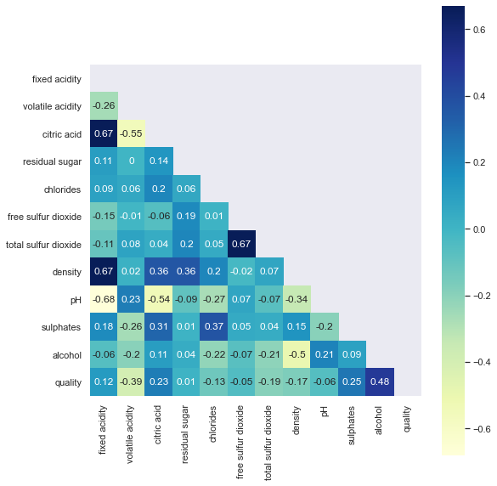
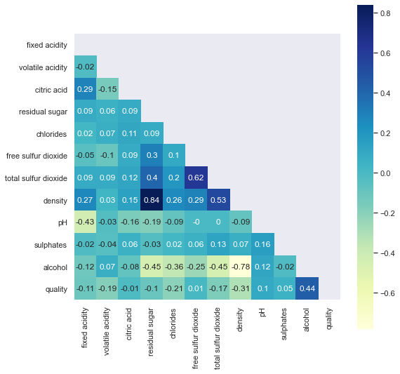
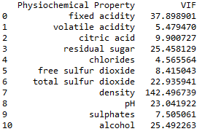
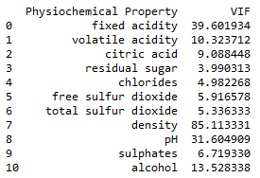
Run regression analyses
1. Model Preparation
Independent variables are on different scales. Need to rescale through normalization.*
2. Run multiple regression model
Assign X (properties) and Y (Quality) → Run
3. Model Validation
Heatmap looking at correlation between variables
Test for multicollinearity via Variance Inflation Factor (VIF) analysis
4. Model reruns
Removing variables with high VIF
and strong correlation
(3 model runs in total for each)
*Normalize: Rescaling real valued numeric attributes into the range 0 to 1. (Machinelearningmastery.com)

Slide 5
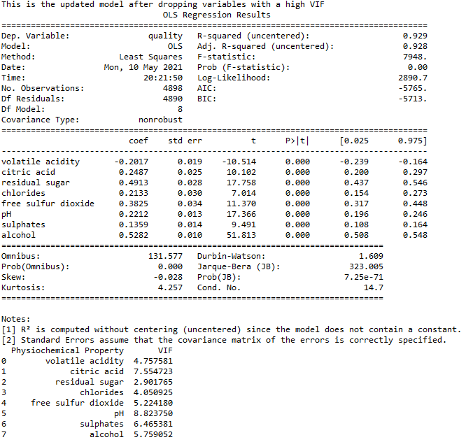
Alcohol has the most impact on the quality of white wine, followed by residual sugar
Model Validation
VIF < 10
2nd run: Removed Density & Fixed Acidity
3rd run: Removed Sulfur Dioxide
Final Model Results
2
1

Slide 6
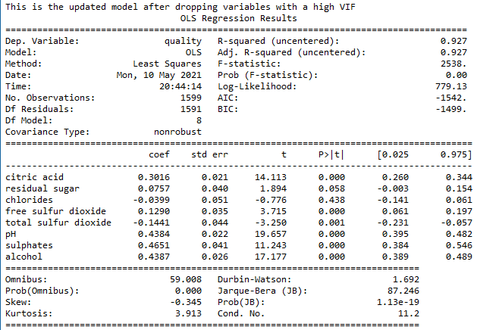
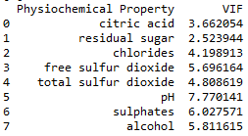
Sulphates have the most impact on the quality of red wine, followed by alcohol and pH
Model Validation
VIF < 10
2nd run: Removed Density & Fixed Acidity
3rd run: Removed Volatile Acidity
Final Model Results
3
1
2
“Fun” Fact!
Wines with higher pH levels require a lot of sulfur to make the wine microbiologically stable; however, there needs to be a balance between sulfur levels and alcohol levels to ensure the wine doesn’t end up tasting like sulfur.

Slide 7
THANK YOU Q&A

